Slide 1
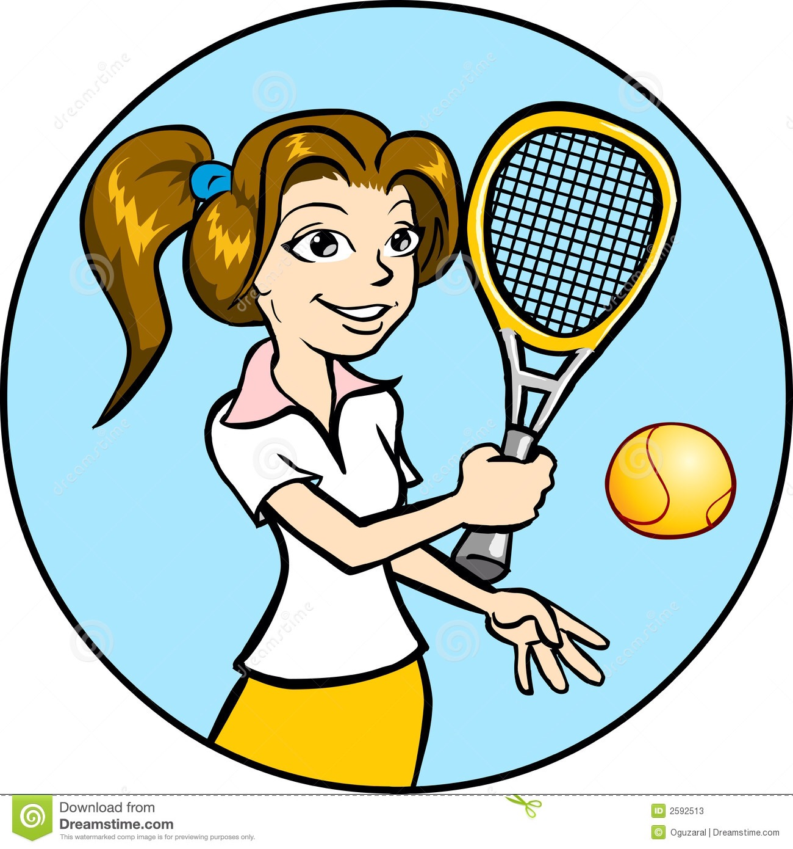
Lesson 1
الصف السادس : اللغة الانجليزية
She is good at playing tennis.

Slide 2
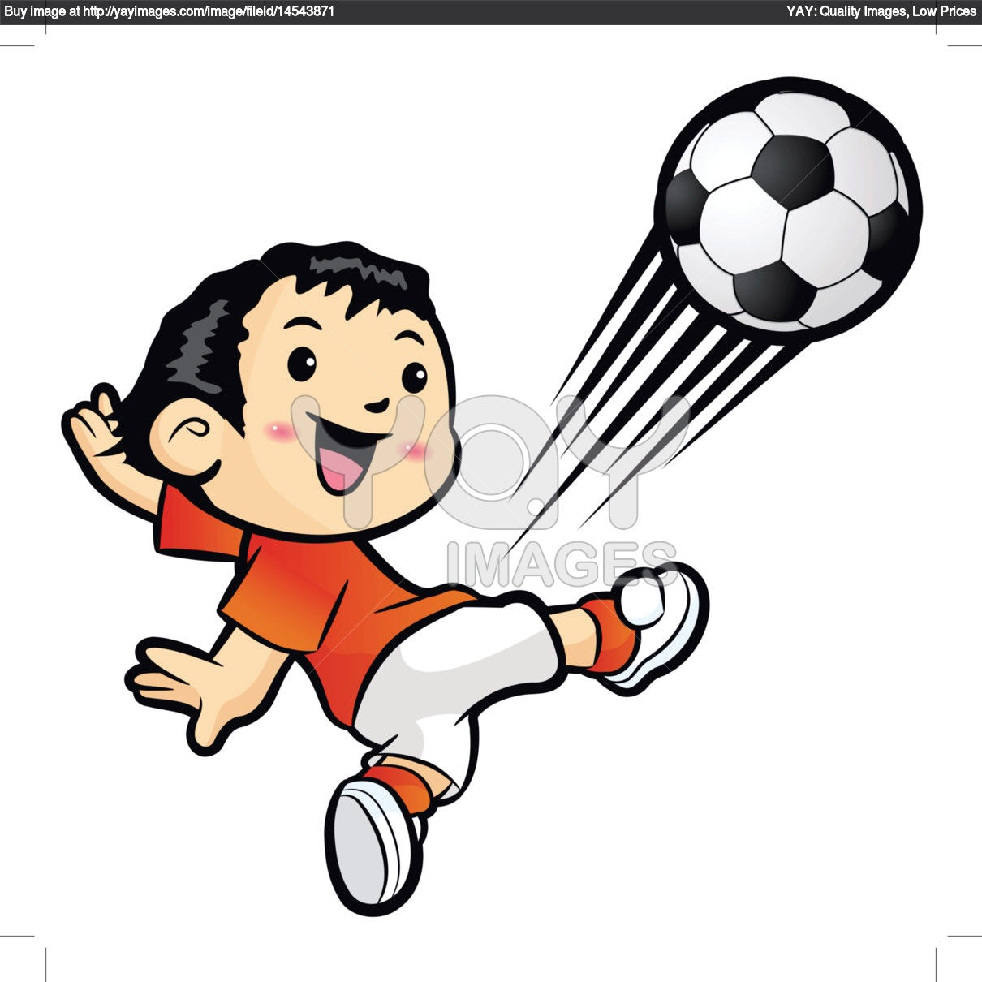
الصف السادس : اللغة الانجليزية
Lesson 1
He is good at playing football

Slide 3
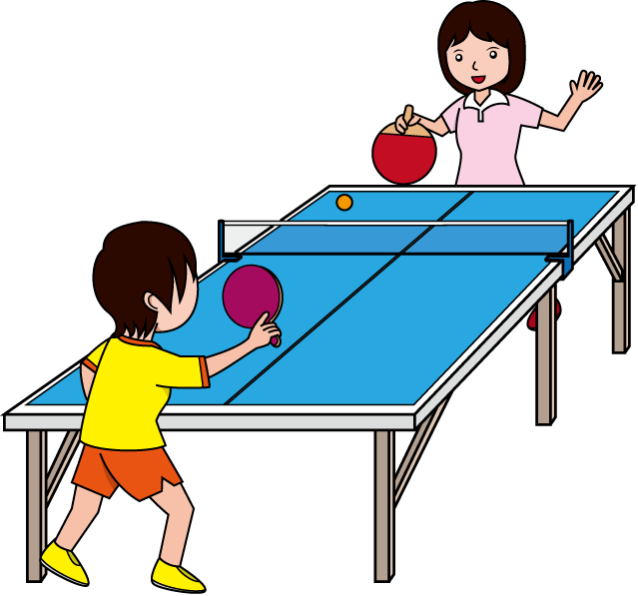
They are good at playing table tennis.

Slide 4
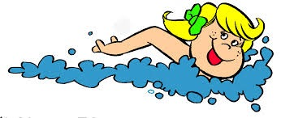
She is good at swimming.

Slide 5
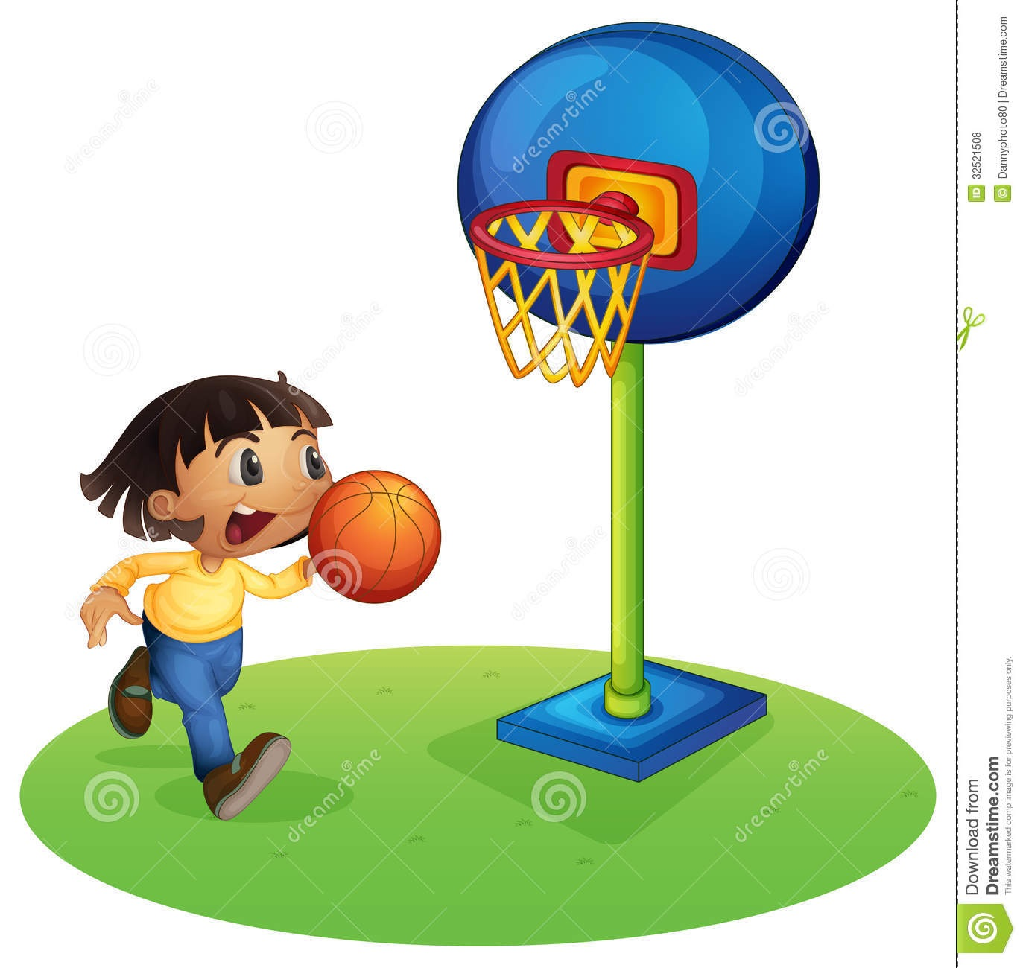
He is good at playing basketball .

Slide 6
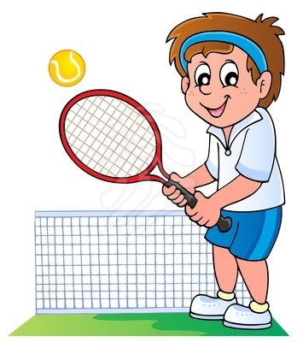
A ball
What do you need to play tennis?
A racket
A net

Slide 7
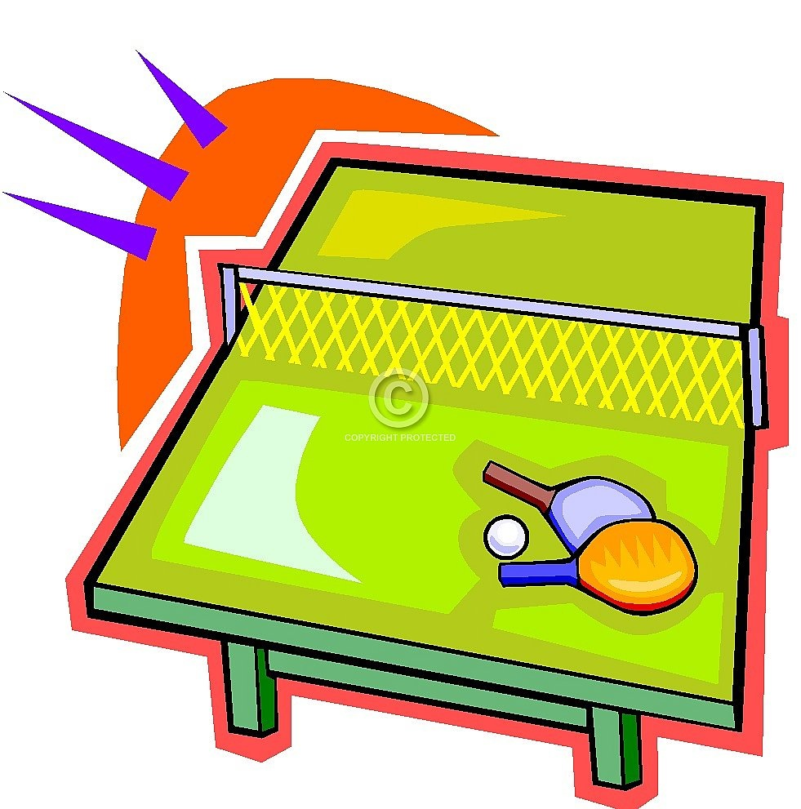
What do you need to play table tennis?
A table
A net
A ball
A bat

Slide 8
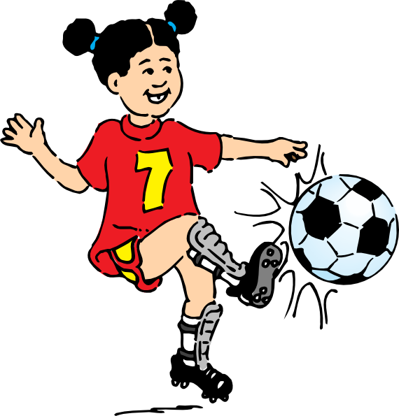
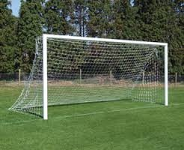
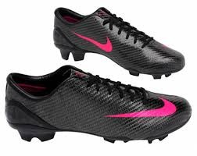
What do you need to play football?
A ball
A net
Football boots

Slide 9
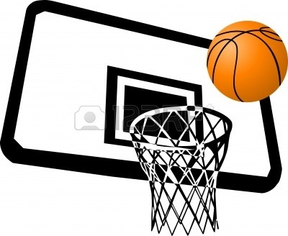
What do you need to play basketball?
A ball
A net basket

Slide 10
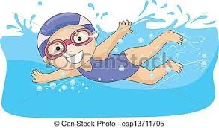
Swimming suit
Goggles
What do you need for swimming?

Slide 11
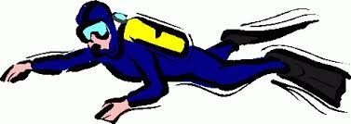

Slide 12
-----------------
------------
-----------

Slide 13
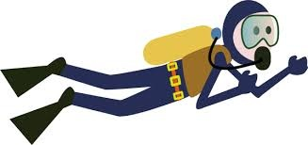
Scuba diving

Slide 15
Look forward to
+
V+ing Noun

Slide 16
*I look forward to visiting England.
*He looks forward to playing tennis.
*She is looking forward to going to the cinema.
*They are looking forward to a holiday.
*We look forward to a new house.

